Slide 1
Green Buildings
Name: Vaka Prasanna
Roll No: 20BQ1A05O6
Section: 4-CSE-D

Slide 2
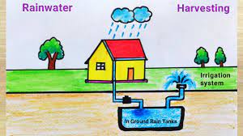

Contents:
What is Green Building?
What is Rain Water Harvesting?
Uses of Rain Water
Commonly Used Methods
What are the Major methods of Rain
Water Harvesting?
Advantages of Rain Water Harvesting

Slide 3
What is a Green Building?
A green building is defined as the one which:
Uses less Water,
Optimizes energy efficiency,
conserves natural resources,
Generates less waste
provides healthier space for occupants compared to Conventional buildings.

Slide 4
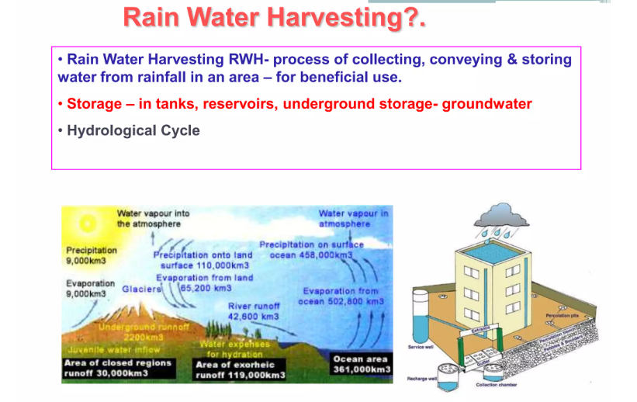
RAIN WATER HARVESTING

Slide 5
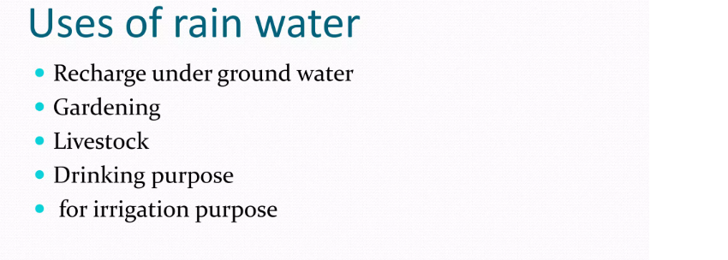
Add a Slide Title - 4

Slide 6
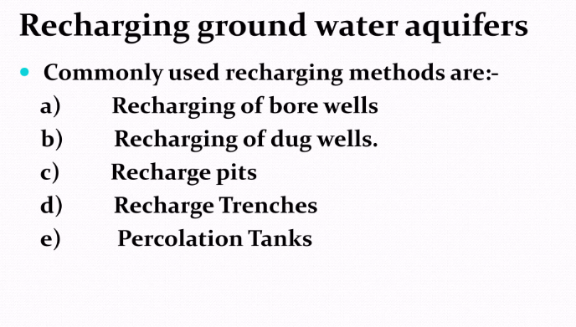

Slide 7
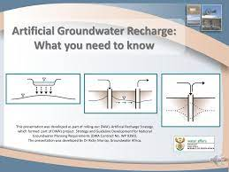
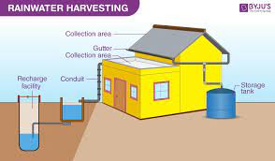
Two major systems that are ideal for urban and semi-urban developed areas are:
Artificial groundwater recharge
Roof-top rainwater harvesting

Slide 8
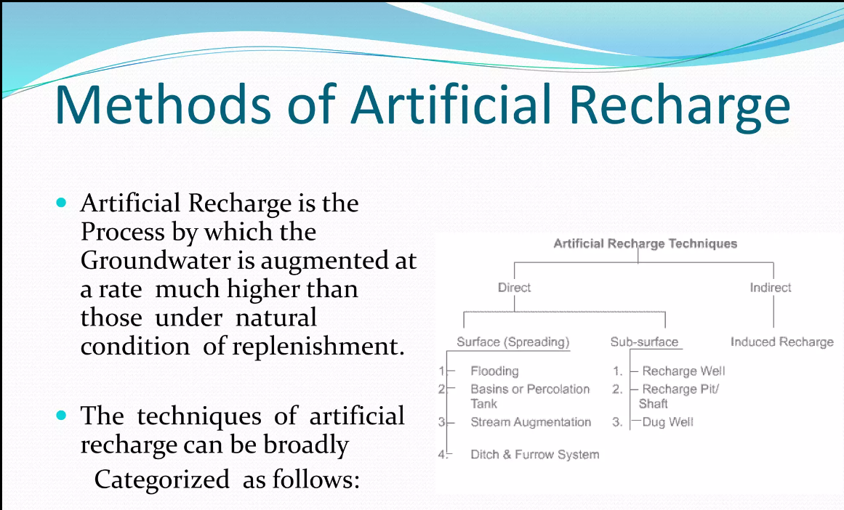
Artificial groundwater recharge

Slide 9
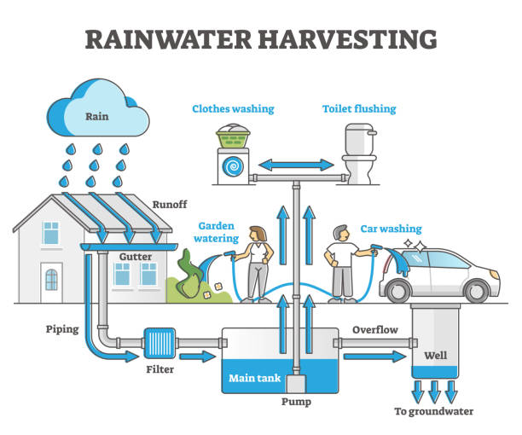
Roof-top Rain Water Harvesting
Roof rainwater harvesting is a common and effective method of collecting rainwater from rooftops and storing it for various uses:

Slide 10
Components of Roof-Top Rain Harvesting:
Catchment Area
Conveyance System
First-Flush Diverter
Filtration
Storage Tanks
Overflow System and Distribution System

Slide 11
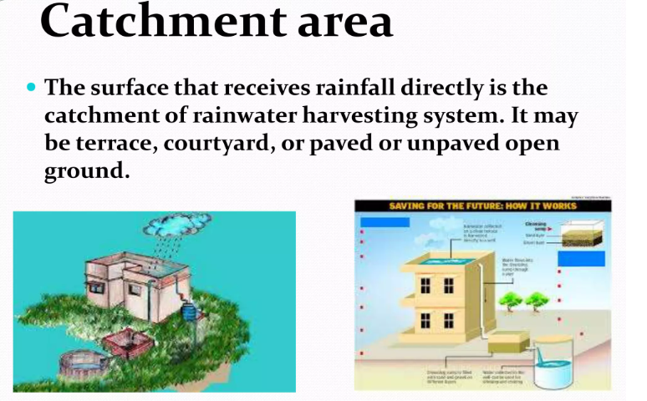
1) Catchment Area
The first step is to identify the catchment area.
It is the surface where rainwater will be collected.
In this case, it's the rooftop of a building.
The catchment area's size and design determine how much rainwater can be harvested.

Slide 12
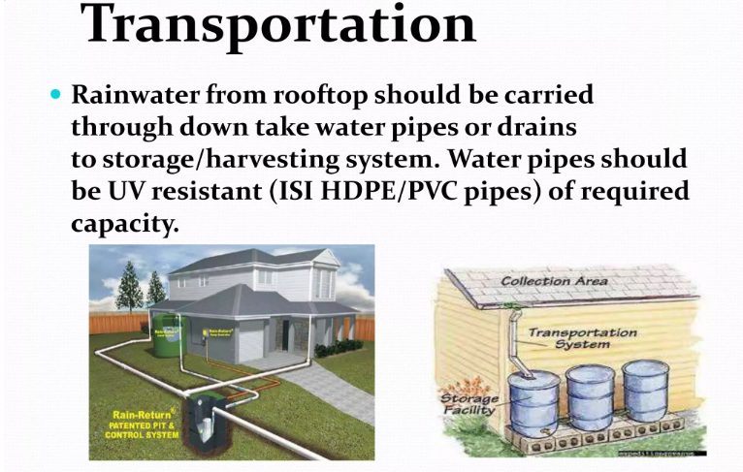
2) Conveyance System
Gutters and downspouts are installed along the edges of the rooftop
This channels rainwater from the catchment area to the storage system.
The gutters collect the rainwater and direct it towards the downspouts.

Slide 13
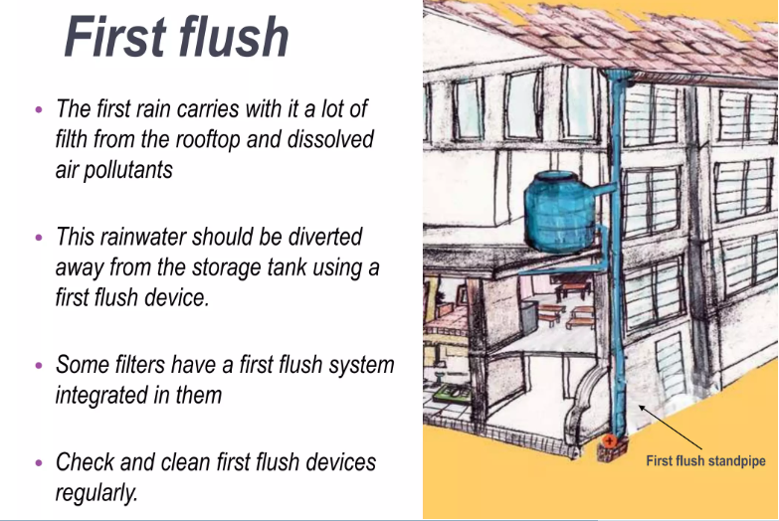
3) First Flush diverter
In some systems, a first flush diverter is installed in the downspout.
This device ensures the initial runoff.
This might contain debris and contaminants from the roof.
It is diverted away before clean rainwater enters the storage system.

Slide 14
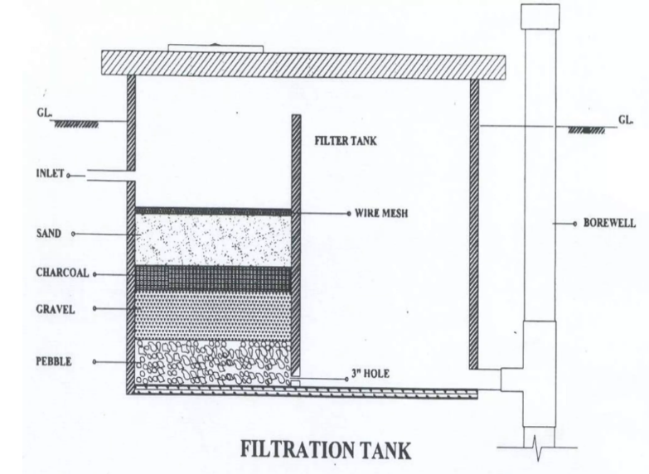
4) Filtration
A filtration mechanism, such as mesh screens or sediment filters, is usually installed along the conveyance path or before the water enters the storage tank.
This filtration removes leaves, debris, and other particles from the rainwater.
Types of Filters are:
Sand Filter
Charcoal filter
PVC pipe filter
Sponge filter

Slide 15
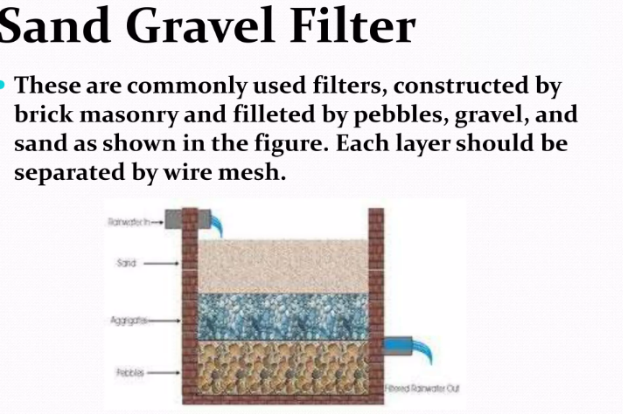
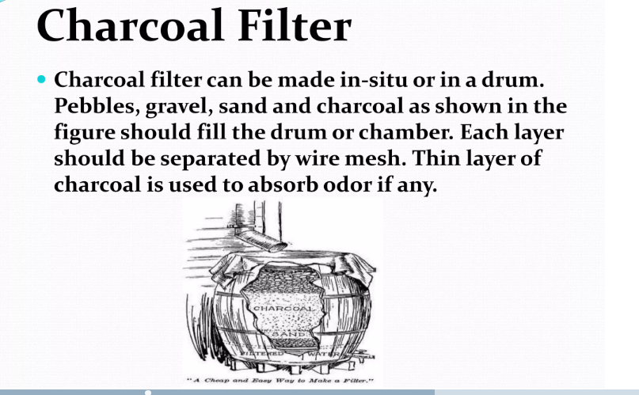
Types of Filters are:
Sand Gravel Filter
Charcoal Filter

Slide 16
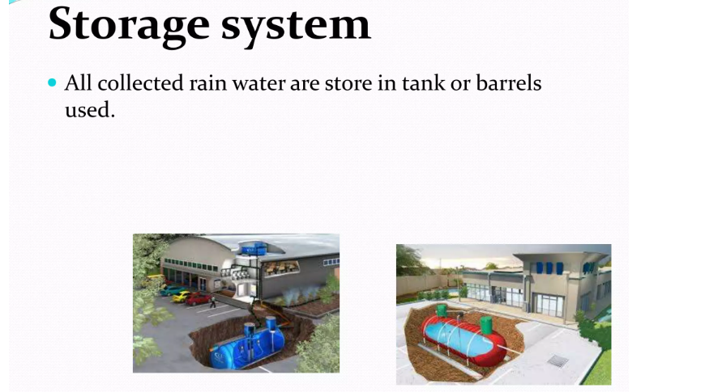
5) Storage Tanks
The filtered rainwater is collected in storage tanks or cisterns.
These tanks can be made of various materials, like
Plastic
Concrete
Metal etc.
The tanks can be located above ground or buried underground, depending on available space and design preferences.

Slide 17
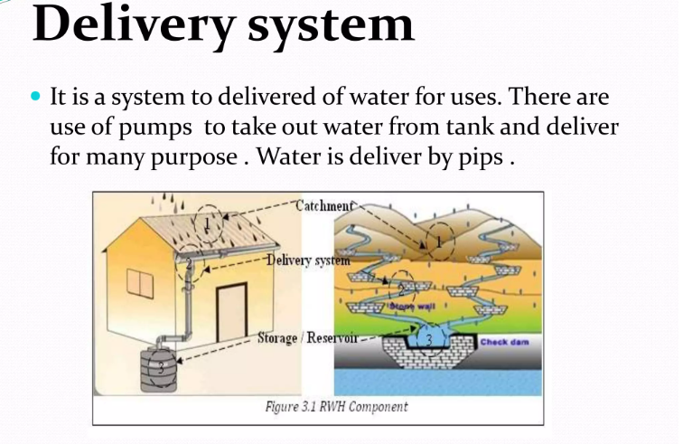
6) Overflow System and Distribution System
Overflow System: To prevent overflow and flooding, an overflow system is installed.
Excess rainwater that cannot be stored is diverted away from the storage tanks and led to a suitable drainage area.
2) Distribution System: When the stored rainwater is to be used, it can be pumped or gravity-fed from the storage tank to its intended end uses.
This might include irrigation, toilet flushing, laundry, or even treatment for potable use, depending on the system's design and water quality.

Slide 18
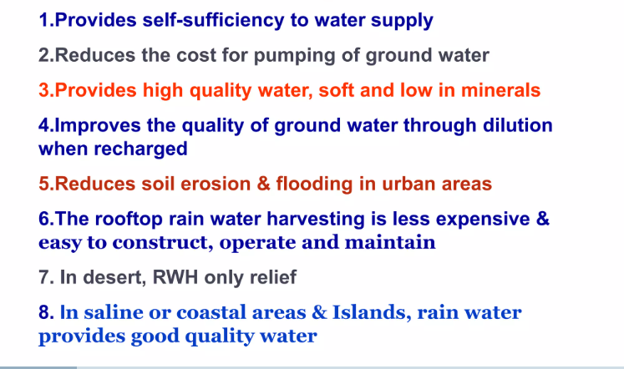
Advantages of Rain Water Harvesting

Slide 19


